Slide 1

Disruption to Test Scores after Tropical Cyclones in the United States
Art by Amy Wolfe
Gabriella Y Meltzer, Joan A Casey, Joel Schwartz, Michelle L Bell, G Brooke Anderson, Marianthi-Anna Kioumourtzoglou, Robbie M Parks
June 21st, 2023
Email: gm3085@cumc.columbia.edu
Twitter: @gabriellameltz

Slide 2

What is a tropical cyclone?
2
Notes:
Time (1 min)
CLICK then leave!
Tropical cyclones, such as hurricanes and tropical storms (such as Henri right now), as you can see an example of here, are intense circular storms that originate over warm tropical oceans and are characterized by low atmospheric pressure, and high wind speeds
They draw energy from the sea surface and maintain strength as long as they remain over warm water
When they make landfall it can be extremely disruptive and very destructive
Several hurricane-force tropical cyclones live long in the memory of many people in the United States
Why should we care about them in relation to health?
CLICK

Slide 3
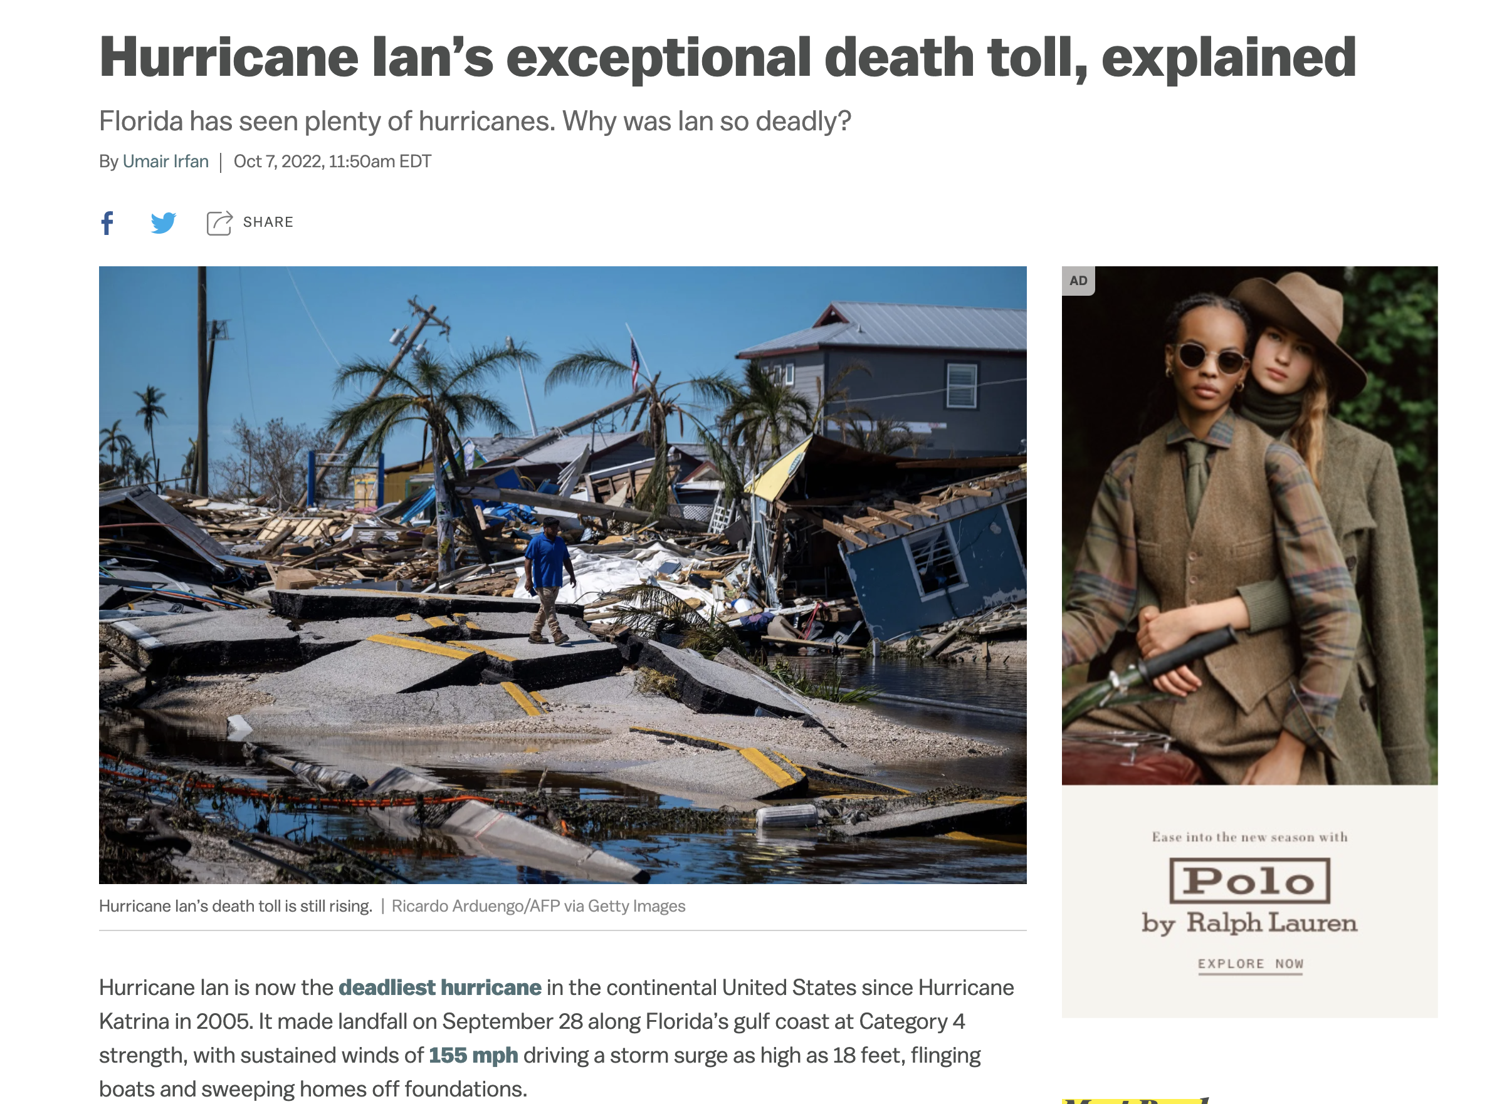

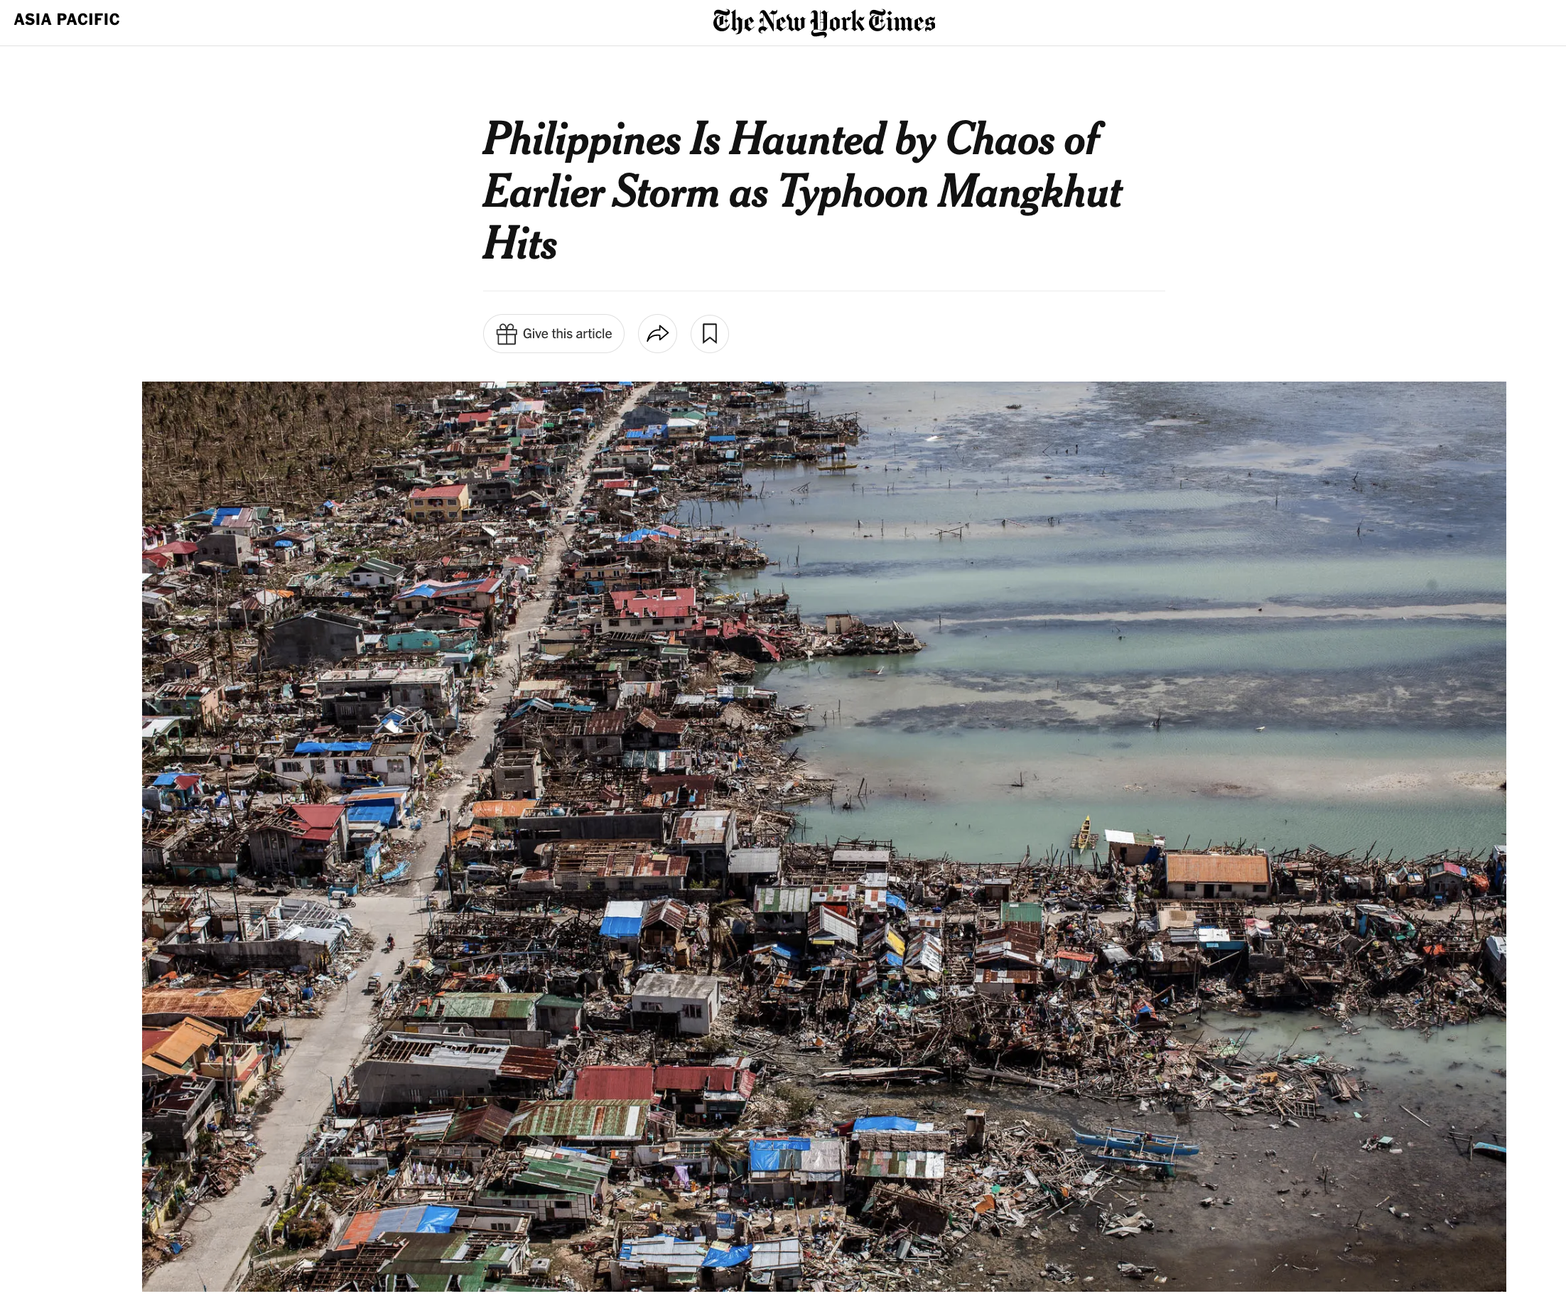
Tropical cyclones in the news
3
Notes:
Time (1 min)
Newspaper cuttings

Slide 4

Tropical cyclones in the news
4
Huffington Post
Notes:
Time (1 min)

Slide 5

US educational system
2001 No Child Left Behind Act requires all states to test academic progress in math and reading/language arts
Tests administered to students in grades 3-8 typically in spring
Paul Morse/White House
5
Notes:
Robbie: Standardized testing
SEDAC info? https://exhibits.stanford.edu/data/catalog/db586ns4974

Slide 6
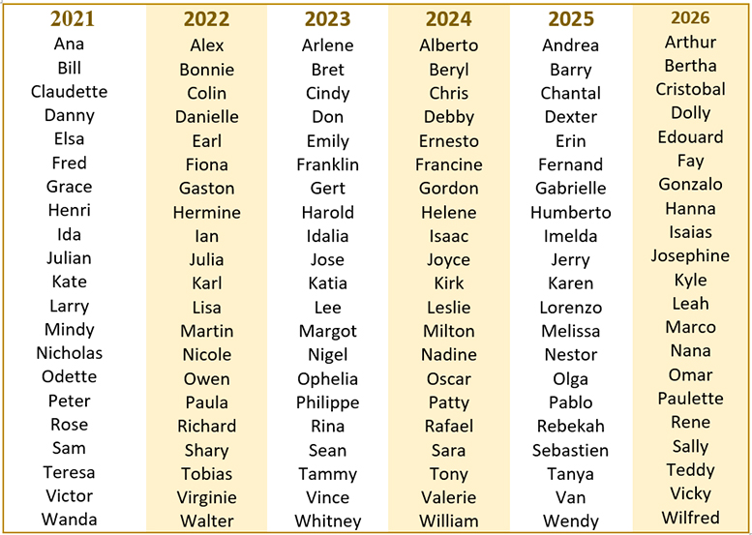



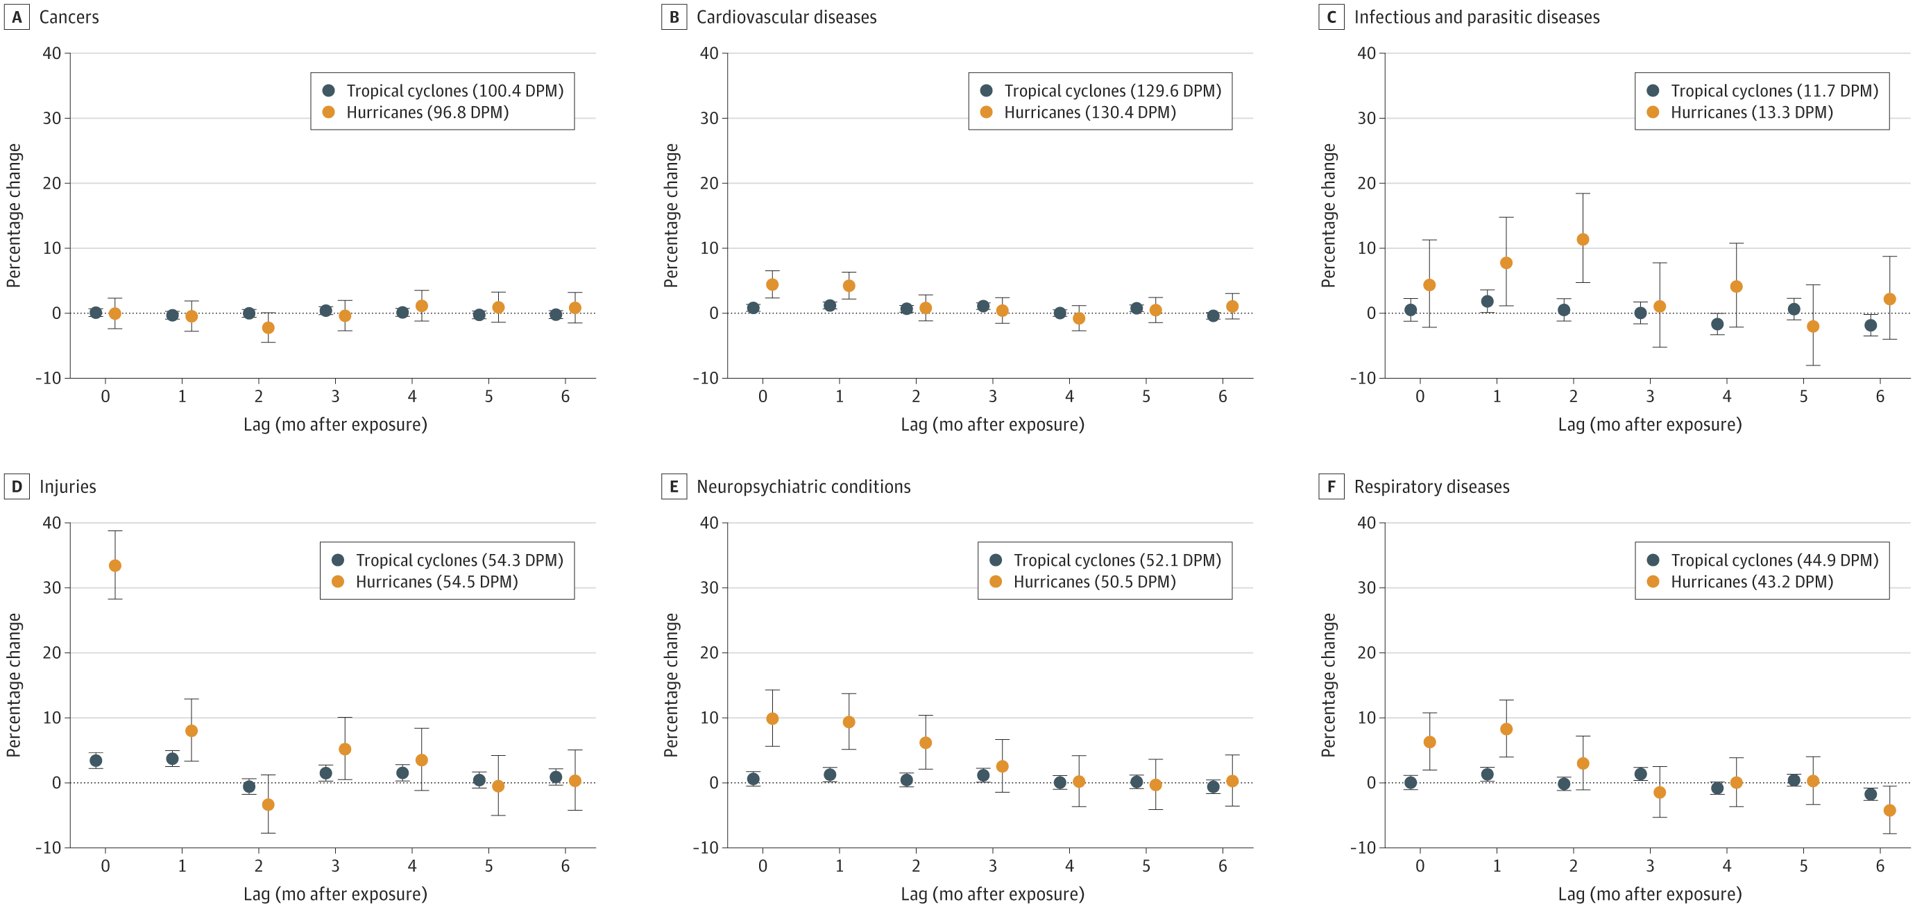
Why should we care about tropical cyclones?
Very active in US
2020 season most active on record
2021: 3rd time on record names exhausted
Will remain a threat in US
Longer landfall and peak closer to land
Extremely costly
Over $2 trillion in damage
Evidence of serious educational consequences
Hurricane Katrina displaced 100k-200k students
Destroyed 78% of New Orleans public school buildings
Serious health consequences
Emerging detailed evidence of mortality and morbidity
Resilience is a matter of environmental justice
Impact low-income and historically disadvantaged communities
Normalized US hurricane damage from 1900 to 2017.
Landward migration of global tropical cyclone activity.
NOAA
Wang and Toumi, Science, 2021
Parks et al., JAMA 2022
Weinkle et al., Nature Sustainability, 2018
NOAA
6
Huffington Post

Slide 7
Disruption to Test Scores after Tropical Cyclones in the United States
Art by Amy Wolfe
Hurricanes and other tropical cyclones have devastating effects on society
A comprehensive assessment of their impacts on educational attainment over multiple years of study is lacking, despite plausible links
Unpublished study, please do not copy or distribute
7
Meltzer et al., In Preparation

Slide 8
Aims
Examine the association between tropical cyclones and educational attainment among elementary- and middle school-age students in all affected areas in the United States
Evaluate how the effects vary by strength of tropical cyclone and by sociodemographic composition of the student bodies and communities affected
Unpublished study, please do not copy or distribute
8
Meltzer et al., In Preparation

Slide 9
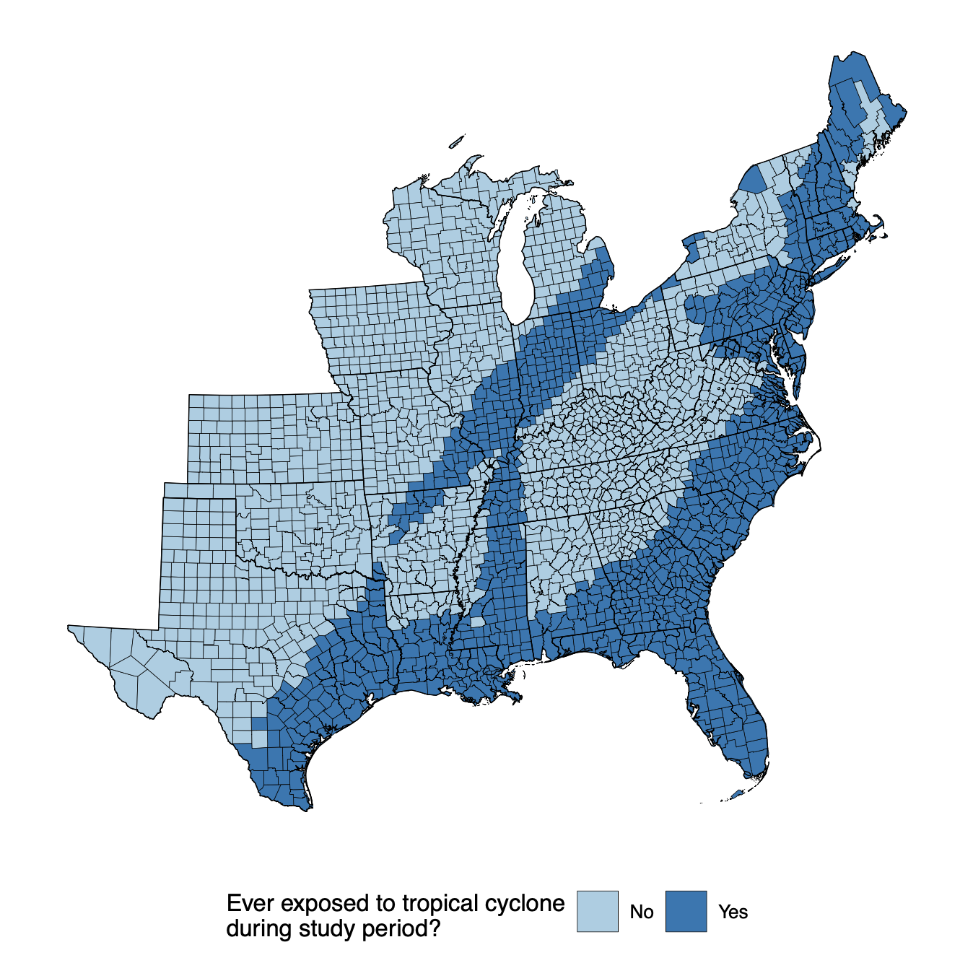
Study population, outcome and exposure assessment
Study population
Third to eighth grade students from 2009-2018 in 2,420 counties in contiguous US
Outcome assessment
County-level average standardized test scores in math and reading/language arts (RLA)
Stanford Educational Data Archive
Exposure assessment
Tropical cyclone exposure
Counties with sustained maximal wind speeds
Tropical cyclones: ⩾ 34 knots
Hurricanes: ⩾ 64 knots
Unpublished study, please do not copy or distribute
9
Meltzer et al., In Preparation
Notes:
The SEDA test scores are scaled such that a score of 4 is equal to the average national NAEP score across four cohorts of students in fourth grade in the spring of 2009, 2011, 2013, and 2015.
According to SEDA documentation, “1 unit in this metric is equal to the average per-grade increase in scores between fourth and eighth grade for those same cohorts, assuming usual grade promotion.” This allows scores to be comparable across the entire US, over time, and across grades
All standardized test are centered around 4 to be representative of the national average. If a grade cohort performs one unit higher, that indicates they are progressing one grade level ahead than the national average. If a grade cohort performs one unit lower, that indicates they are performing one grade level behind the national average.

Slide 10
Statistical model
County poverty tertiles
Association between average Math and RLA and tropical cyclone exposure:
Difference-in-difference model
To quantify association:
Associations modeled by tropical cyclones and hurricanes
Associations modeled nationally and by state
Effect modification by county and grade cohort level characteristics
Adjusted for time-varying grade-cohort and county-level covariates:
Grade-cohort: race/ethnicity, economic disadvantage, free/reduced lunch, ESL learners
County: college degree, poverty, household income, urbanicity, SNAP recipients, single mother households
Unpublished study, please do not copy or distribute
10
Meltzer et al., In Preparation

Slide 11
Results: National model
Full regression results of county-level standardized test scores on hurricane exposure and covariates
 | Math: β (95% CrI) | RLA: β (95% CrI)
Hurricane exposure | 0.00 (-0.05, 0.05) | 0.01 (-0.04, 0.05)
Native American | -1.13 (-1.95, -0.31) | -1.64 (-2.35, -0.94)
Hispanic/Latino | -0.97 (-1.13, -0.80) | -1.63 (-1.77, -1.49)
Black | -1.99 (-2.16, -1.83) | -2.25 (-2.40, -2.10)
Free-lunch eligible | -0.31 (-0.39, -0.24) | 0.14 (0.08, 0.20)
Reduced-price lunch eligible | -0.20 (-0.47, 0.07) | 0.47 (0.24, 0.69)
Economically disadvantaged | -0.04 (-0.11, 0.03) | -0.60 (-0.66, -0.54)
English language learner | 0.59 (0.12, 1.06) | -1.13 (-1.52, -0.75)
Urban | 0.12 (-0.03, 0.27) | 0.21 (0.08, 0.33)
Log of median household income | 0.07 (-0.04, 0.18) | 0.01 (-0.08, 0.10)
Bachelor's degree rate | 2.01 (1.67, 2.35) | 1.79 (1.51, 2.08)
Poverty rate | -0.75 (-1.07, -0.43) | -0.05 (-0.31, 0.21)
SNAP receipt rate | -0.22 (-0.50, 0.06) | 0.19 (-0.04, 0.43)
Single-mom household rate | 0.08 (-0.23, 0.38) | 0.05 (-0.21, 0.30)
Unpublished study, please do not copy or distribute
11
Meltzer et al., In Preparation
Notes:
The following variables are percentage of grade cohort: racial/ethnic groups, free and reduced lunch eligible, economically disadvantaged (defined by the state), English language learners
The following variables are percentage of county residents: SNAP recipients, single-mother headed households, households in poverty, those ages 25+ with at least a bachelor’s degree
Median household income is in thousands of dollars
Urban is percent of the county land area considered urban (as opposed to suburban, town, or rural)

Slide 12
Results: State-specific model
Regression of county-level standardized test scores on hurricane exposure and covariates, state-specific results
 | Math: β (95% CrI) | RLA: β (95% CrI)
Overall | 0.00 (-0.05, 0.05) | 0.00 (-0.04, 0.05)
Alabama (1) | 0.13 (-0.04, 0.32) | 0.04 (-0.08, 0.17)
Florida (12) | 0.19 (0.11, 0.27) | 0.07 (0.00, 0.13)
Georgia (13) | -0.07 (-0.17, 0.03) | 0.00 (-0.08, 0.08)
Louisiana (22) | -0.02 (-0.26, 0.21) | 0.00 (-0.16, 0.16)
New Jersey (34) | -0.12 (-0.34, 0.06) | -0.03 (-0.17, 0.10)
North Carolina (37) | -0.15 (-0.26, -0.04) | 0.04 (-0.05, 0.13)
South Carolina (45) | -0.19 (-0.42, 0.06) | 0.02 (-0.12, 0.15)
Texas (48) | -0.10 (-0.21, 0.01) | -0.13 (-0.21, -0.05)
Unpublished study, please do not copy or distribute
12
Meltzer et al., In Preparation

Slide 13
Results: Effect modification by cohort race/ethnicity
Effect measure modification by grade cohort race/ethnicityª: hurricane coefficient/interaction term coefficients
 | Math: β (95% CrI) | RLA: β (95% CrI)
Tertile 1 | 0.00 (reference) | 0.00 (reference)
Tertile 2 | -0.06 (-0.46, 0.35) | -0.10 (-0.45, 0.26)
Tertile 3 | -0.01 (-0.41, 0.39) | -0.04 (-0.39, 0.31)
ªPercentage of Black, Hispanic/Latinx, and Native American students
Unpublished study, please do not copy or distribute
13
Meltzer et al., In Preparation
Notes:
Robbie: please make this slide match positions and size of next slide

Slide 14
Results: Effect modification by county poverty rate
Effect measure modification by county poverty rate: hurricane coefficient/interaction term coefficients
 | Math: β (95% CrI) | RLA: β (95% CrI)
Tertile 1 | 0.00 (reference) | 0.00 (reference)
Tertile 2 | -0.09 (-0.20, 0.02) | -0.12 (-0.21, -0.03)
Tertile 3 | -0.08 (-0.20, 0.03) | -0.04 (-0.14, 0.06)
Unpublished study, please do not copy or distribute
14
Meltzer et al., In Preparation

Slide 15
Summary
Negative association between hurricanes and standardized test scores only observed in some states
North Carolina (math)
Texas (RLA)
Florida (positive)
Certain groups at greater risk of lapses in educational attainment
Native American, Black, Hispanic/Latinx
Low socioeconomic status
English language learners (RLA)
Next steps
Evaluate all tropical cyclones in addition to hurricanes
Analyze lagged effects of fall hurricane season on following spring testing
Unpublished study, please do not copy or distribute
15
Meltzer et al., In Preparation

Slide 16



Co-authors, collaborators, and funding
University of Washington
Joan Casey
Columbia University
Gabriella Y Melzter, Marianthi-Anna Kioumourtzoglou, Robbie M Parks
Harvard University
Joel Schwartz
Yale University
Michelle L Bell
Colorado State University
G Brooke Anderson
Supported by:
5T32ES007322-21
R00ES033742
16

Slide 17
Disruption to Test Scores after Tropical Cyclones in the United States
Art by Amy Wolfe
Gabriella Y Meltzer, Joan A Casey, Joel Schwartz, Michelle L Bell, G Brooke Anderson, Marianthi-Anna Kioumourtzoglou, Robbie M Parks
June 21st, 2023
Email: gm3085@cumc.columbia.edu
Twitter: @gabriellameltz

